Slide 1
An Introduction to Machine Learning
Aditya Devarakonda
1/14/20

Slide 2
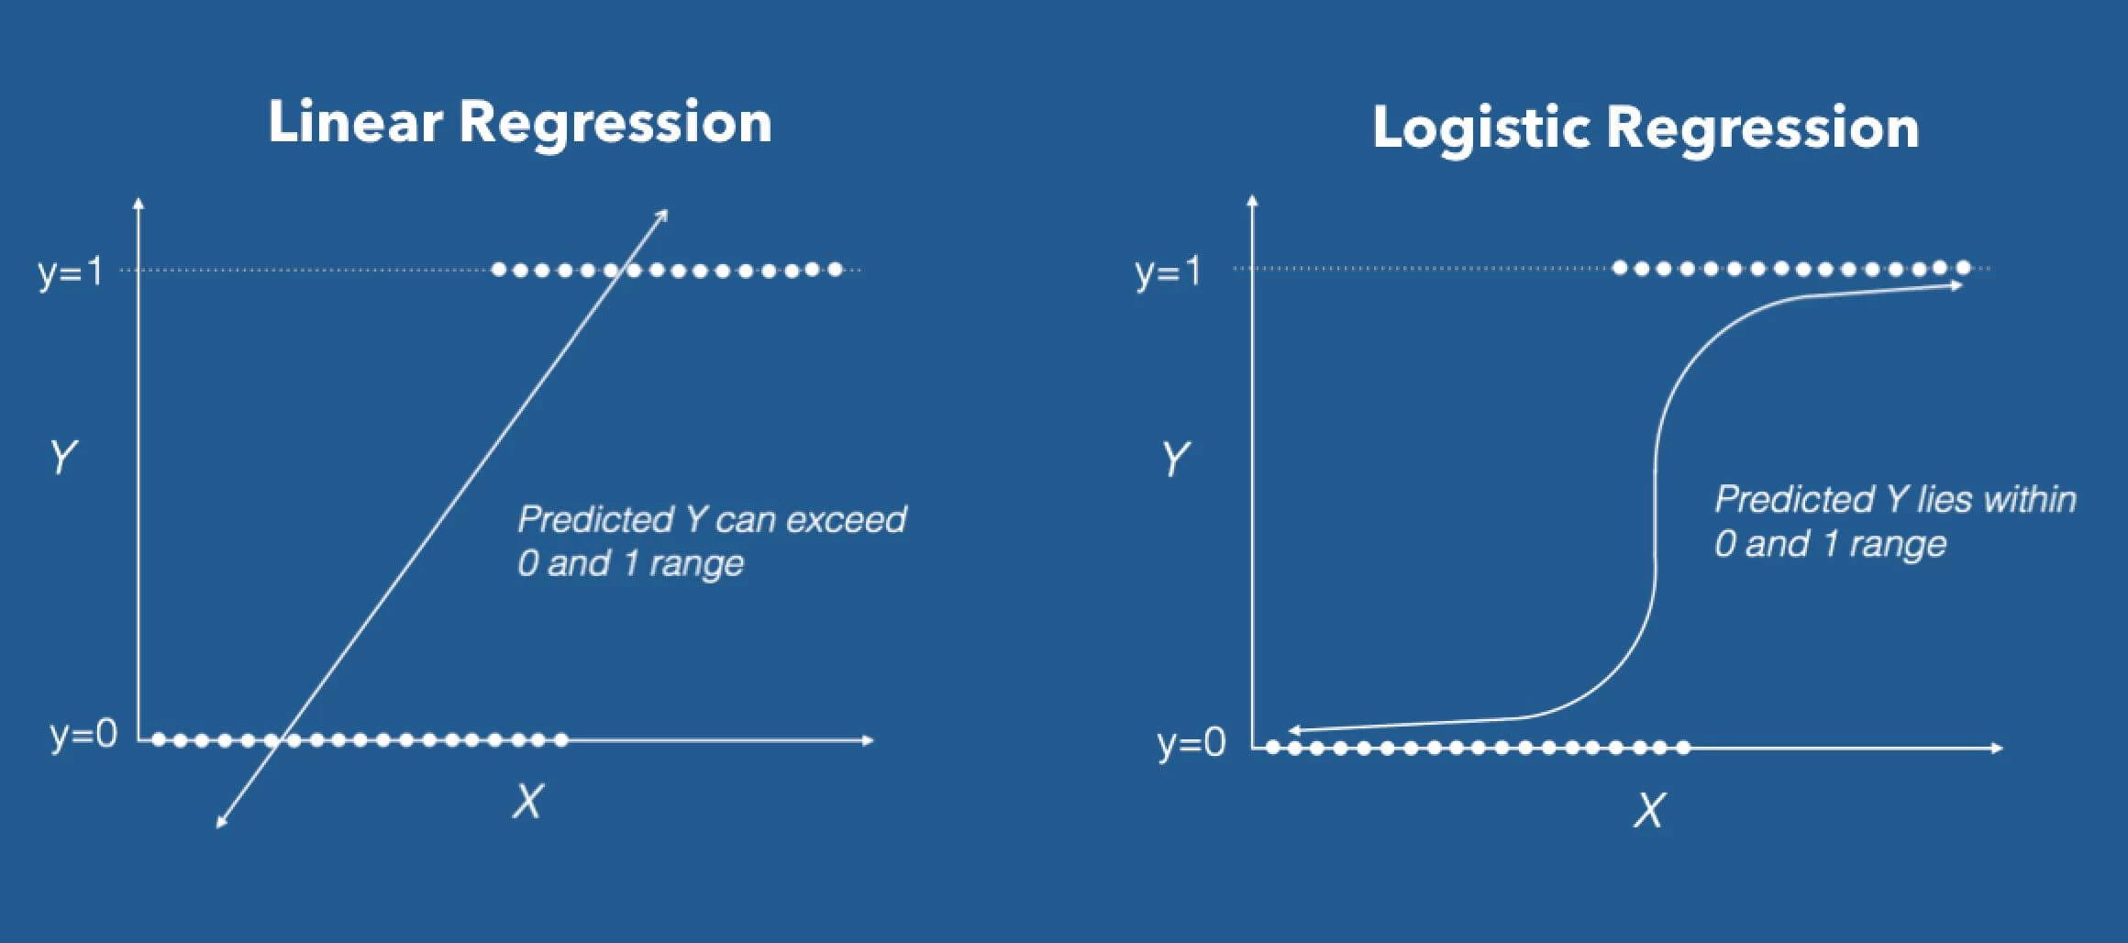
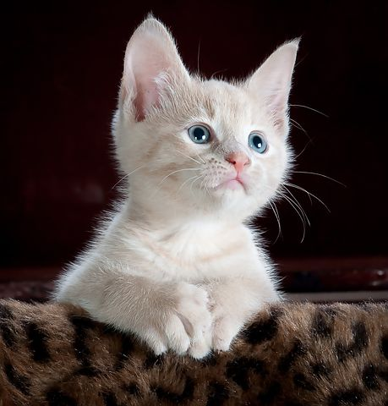
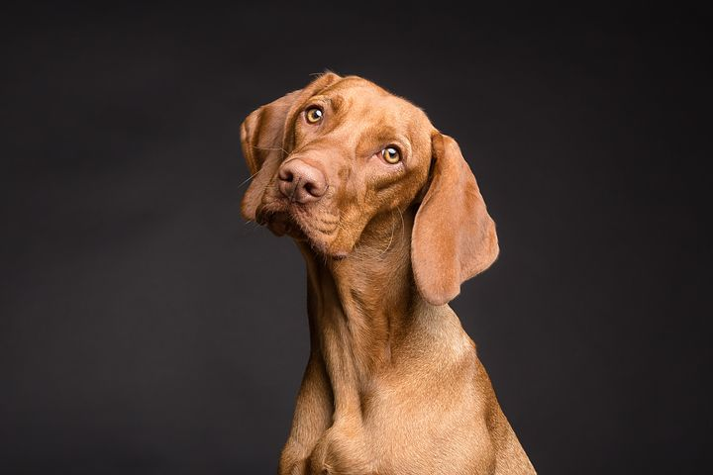
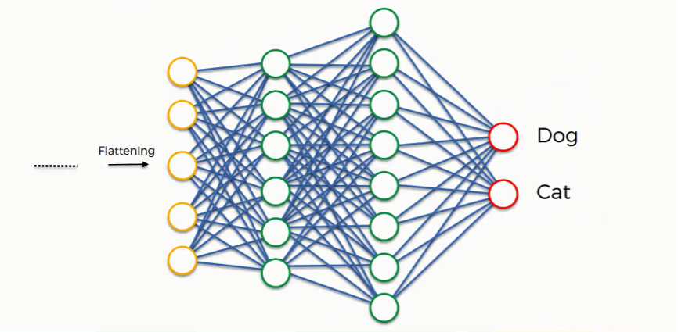
Outline
The Regression Problem:
The Classification Problem:
Feedforward Neural Networks (FNNs)
Convolutional Neural Networks (CNNs)

Slide 3
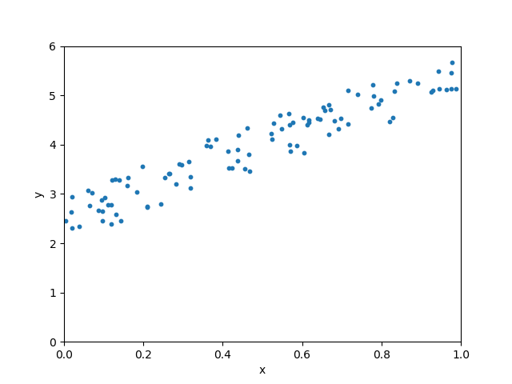
Regression
We are given some (x, y) data.
What can we learn from this data?

Slide 4
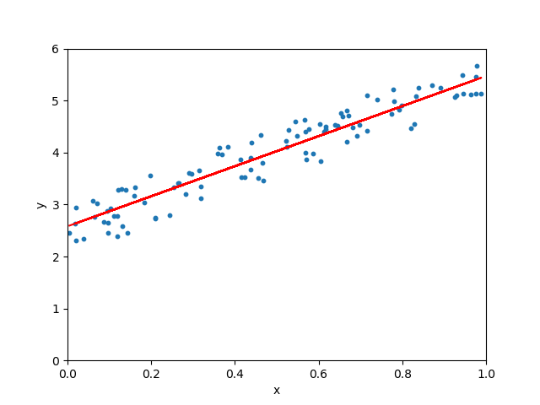
Regression
Blue dots = Data
Red line = Regression
One of the simplest machine learning models.

Slide 5
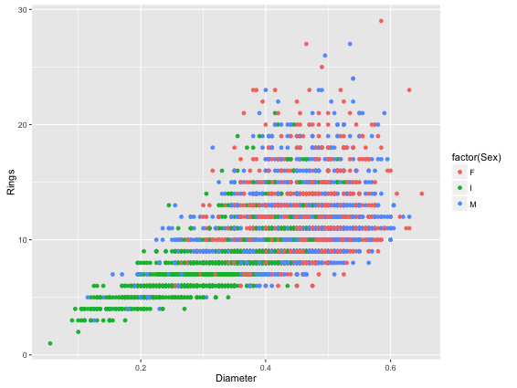
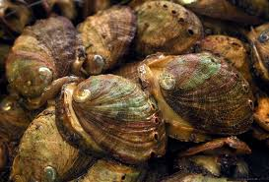
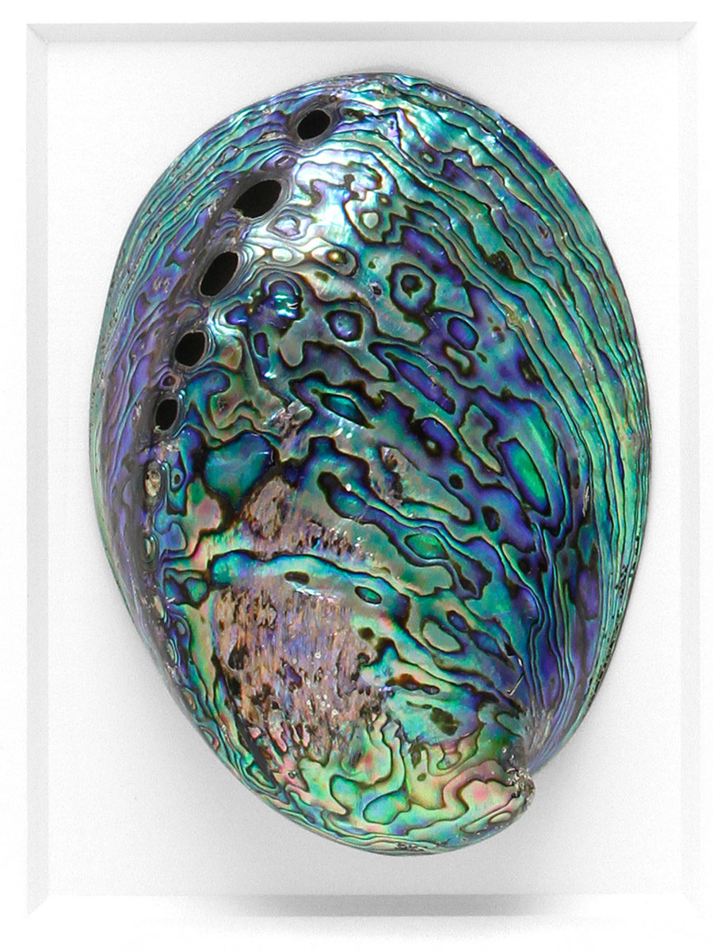
Regression
Real example: predicting age in abalone.
Gender

Slide 6
Regression
After regression, we can:
Predict number of rings from diameter.
Gender

Slide 7
Classification
Email spam filtering.
Spam
Not Spam

Slide 8
Classification
Spam
Linear Regression
Not Spam

Slide 9
Classification
Above line = Spam
Below line = Not Spam

Slide 10
Classification
What if we get another spam email?
Below line = not spam
So new email is misclassified!

Slide 11

Classification
What if training dataset had an outlier?
$$0.5$$
Green line is a better predictor.

Slide 12






Simple Model
Single-layer perceptron
$$a_{1}$$
$$a_{2}$$
$$a_{3}$$
$$\text{output}$$
.
.
.
$$\text{activation} \text{function}$$
$$a_{n}$$
One data point

Slide 13
Feedforward Neural Networks
Multi-layer perceptron
Layer 2
Layer 3 / Output Layer
Layer 1 / Input Layer

Slide 14
Feedforward Neural Networks
Multi-layer perceptron Forward Propagation
Step 1: Data flows from Layer 1 to Layer 2. Step 2: Data flows from Layer 2 to Layer 3.
We can add as many layers as necessary.
Layer 2
Layer 3
Layer 1 / Input Layer

Slide 15
Feedforward Neural Networks
Step 1: Forward propagation gives us a prediction.
Step 2: Check if prediction is correct.
Step 3: Update the orange nodes if prediction is incorrect.
Called Backward Propagation.
Layer 2
Layer 3
Layer 1 / Input Layer

Slide 16
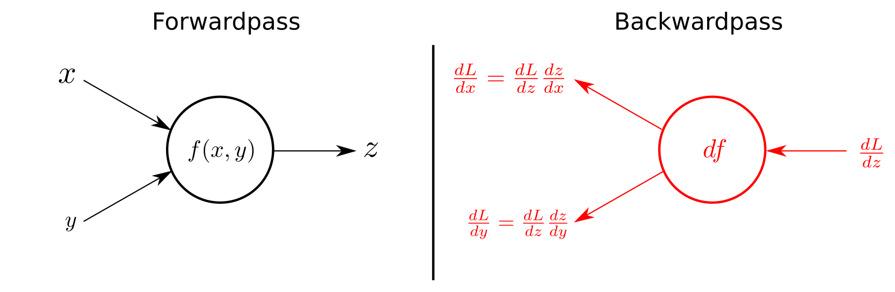
Feedforward Neural Networks

Slide 17
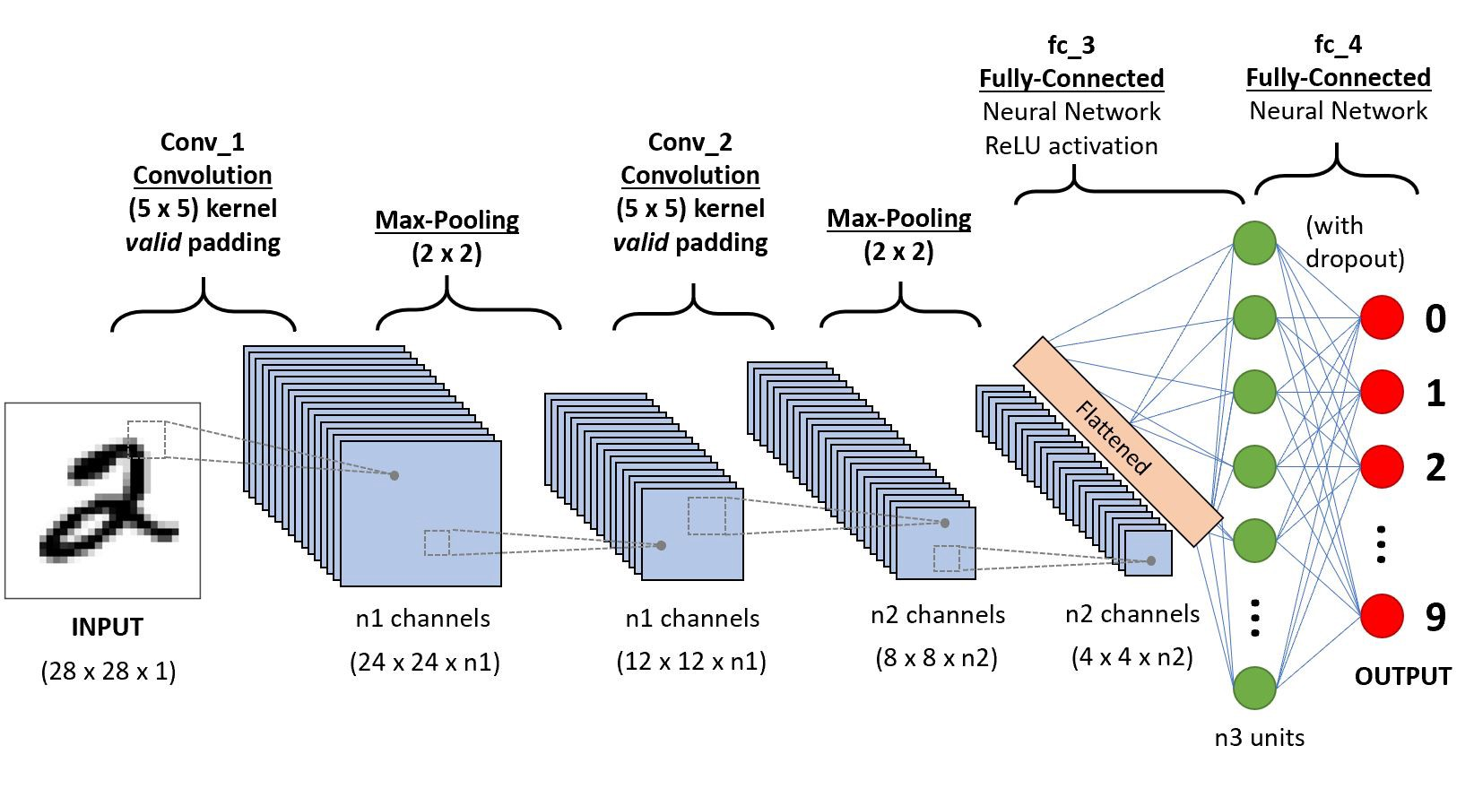
Convolutional Neural Networks (CNNs)

Slide 18
Convolutional Neural Networks (CNNs)
Let’s begin by first looking at the convolution operation.
Orange = filter.
Multiply each each cell of image with corresponding cell in filter.
Output cell = sum over convolved cells.
How about for color images?

Slide 19
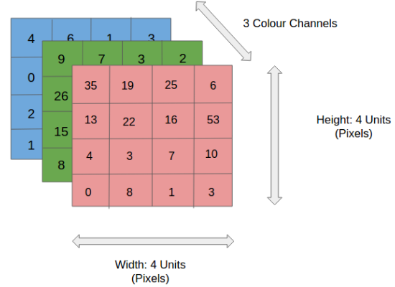
Convolutional Neural Networks (CNNs)
Input image is Red, Green, Blue (RGB) intensities.

Slide 20
Convolutional Neural Networks (CNNs)

